Slide 1


Strategies and Challenges in Conducting Randomized Control Trials (RCTs):
Experiences from the PACT Evaluation
Fatherhood Research and Practice Network Webinar
March 3, 2015
Heather Zaveri, Scott Baumgartner, Robin Dion, Sarah Avellar, and Reggie Covington (Mathematica Policy Research)
Guy Bowling (Goodwill/Easter Seals of MN)
Brandi Jahnke (Connections to Success)

Slide 2





Today’s Speakers
Robin Dion
PACT Project Director
Sarah Avellar
Lead on PACT Impact Study
Heather Zaveri
PACT Deputy Project Director
Guy Bowling
FATHER Project
Goodwill/Easter Seals
Brandi Jahnke
Connections to Success

Slide 3
Webinar Structure
Overview of PACT
Brief description of participating programs
Setting the stage for a rigorous evaluation
Getting fathers in the door
Providing services
Keeping men engaged

Slide 4
PACT: A Foundation for Informing RF Field
Process: How were PACT programs designed and implemented?
Impact: Do programs improve outcomes for enrolled fathers?
Qualitative Study: How do fathers view and carry out their roles of parents, providers, and partners?
Descriptive Study of Hispanic Programs: What makes fatherhood programs serving Hispanic men culturally-sensitive?

Slide 5
Process, Impact, and Qualitative Components
Mixed-method process study (informs today’s presentation)
  Staff interviews and web survey
  Enrollment and participation data
  Focus groups with participating fathers
Experimental impact evaluation
  Fathers complete baseline interview and are randomly assigned to the program or a control group that can receive other community services (the counterfactual)
  Twelve month follow-up survey with fathers in both groups
  Administrative data on fathers from NDNH
Longitudinal, in-depth, in-person semi-structured interviews with fathers (“qualitative study”)

Slide 6
Selected Programs Met Criteria for Rigorous Evaluation
Size
  Large enough to meet statistical power expectations
  Excess demand for services to enable enrollment in a control group
Intervention strength and counterfactual
  Offer parenting, relationship, and economic stability services that met a minimum threshold
  Strong counterfactual
Ability to be pooled with other programs
  Provide content in the same core areas
  Point of random assignment

Slide 7
Programs Agreed to Selected Evaluation Activities
 | Program Conducts | Mathematica Conducts
Conduct outreach to identify interested fathers | X
Describe program and random assignment to interested fathers | X
Connect fathers to interviewer for baseline survey | X
Obtain verbal consent and conduct baseline survey |  | X
Conduct random assignment |  | X
Serve program group fathers and track their participation | X
Support program delivery (including recruitment/retention) through monitoring and technical assistance |  | X
Locate fathers and conduct follow-up survey |  | X
Analyze data and report results |  | X

Slide 8
Four Responsible Fatherhood Programs in the PACT Evaluation

Slide 9
Integrated Cohort Approach
Successful STEPS Program, Connections to Success, KC
  Three-week daily workshop integrating workforce readiness and parenting content
Family Formation Program at Fathers’ Support Center, St. Louis
  Six-week daily workshop integrating parenting, employment, and relationship content throughout
Common program features
  Daily, full-day workshop
  Cohort approach
  Core content integrated
  Individual employment support
  Case management and follow-up services

Slide 10
Open-Entry Workshop Approach
FATHER Project at Goodwill/Easter Seals, Minneapolis/St. Paul
  Separate, weekly 2-hour workshops for parenting and relationships
  Full-day, stand-alone employment workshop offered twice monthly
  Individual fatherhood plan specifies program activities and goals for father
Center for Fathering at Urban Ventures, Minneapolis
  Separate, weekly 1.5-hour workshops for parenting, relationships, and job readiness
Common program features
  Weekly/biweekly attendance
  Open-entry/open-exit approach
  Menu of services, core content not integrated
  Case management and individual employment support

Slide 11
Fathers in Four RF Programs Have Multiple Challenges
Characteristics
Family Structure
 | Overall
Age (years) | 35
Black, Non-Hispanic | 81%
HS Diploma or GED | 69%
Recent Paid Work | 50%
Ever Convicted of Crime | 73%
 | Overall
Number of Children | 2.6
Children by Multiple Mothers | 47%
Have Formal Child Support Arrangement | 58%
Recent Time with Child | 80%
Source: PACT Baseline Survey Data, through 8/22/14. N = 4,734 fathers.
Note: Programs began PACT intake between 12/9/12 and 2/13/13.

Slide 12
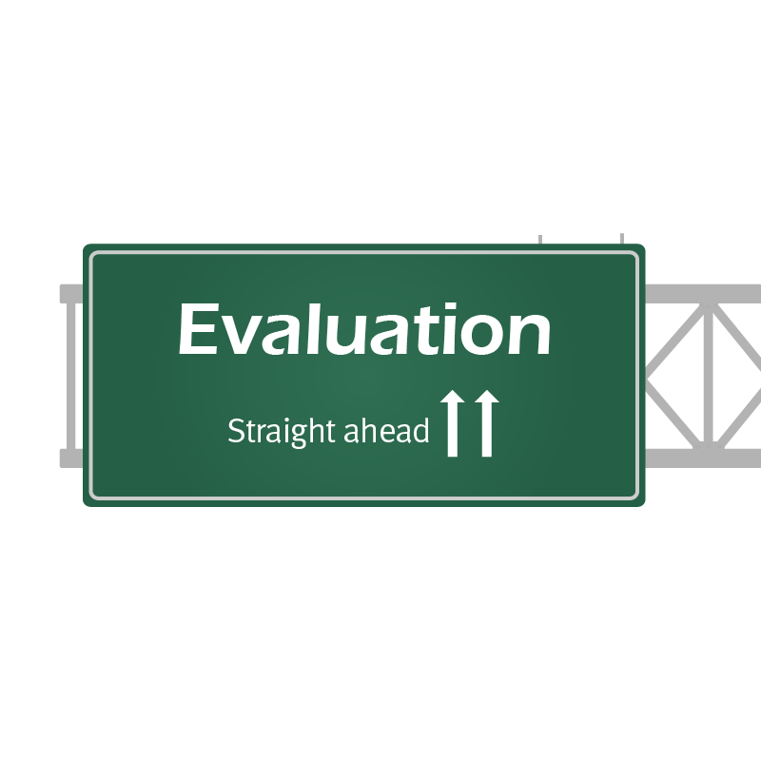
The Road to a
Successful Evaluation
When evidence is strong, we should act on it. When evidence is suggestive, we should consider it. When evidence is weak, we should build the knowledge to support better decisions in the future.
Zients, 2012 (www.whitehouse.gov/sites/default/files/omb/memoranda/2012/m-12-14.pdf)

Slide 13
Avoiding Bias in RCTs
A well-executed RCT provides unbiased estimates of the program’s effect
  Key strength: program and control groups are the same, on average, at the point of random assignment
  Any subsequent differences between the groups can be attributed to the program
Flaws in design or execution can weaken the rigor of an RCT
Common problems
  Reassignment
  Attrition
  Confounding factors
  Other aspects of data collection and analysis

Slide 14
Reassignment
Reassignment: Changing a father’s assigned group after random assignment
  Adding control group fathers who receive program services to the program group during analysis
  Reassigning program group fathers who say they cannot attend services to the control group
Reassignment may create systematic differences in the groups, which can bias impact estimates
  Underlying characteristics may drive behavior, for example, more motivated control group members seeking program services
Solution: Stick with original random assignment regardless of later behavior
  For the best test, minimize cross-overs (members of the control group receiving services) and maximize participation (members of the program group engaging in services)

Slide 15
Attrition
Attrition: Missing data for fathers in the sample
Although random assignment creates similar groups (on average), attrition can change the composition of the groups
  For example, less motivated people in the program group are overwhelmed and more of them fail to respond to the follow-up
Two types of attrition, both threaten integrity of the evaluation
  Overall attrition is the combined loss of data for any sample member from either the program or the control group
  Differential attrition refers to the difference in the rate of attrition between the program and control groups
Solution: Maximize response rates
  Minimizing differential attrition is more important than minimizing overall attrition

Slide 16
Confounding Factors
Confounding factor: Alignment of some aspect of the design with the study condition; that is, something other than services differs between program and control groups
Common confounding factors
  Differences in data collection, i.e., timing or who is collecting data
  Differences in services other than those being studied
  Only one person delivering treatment
Evaluation cannot distinguish program impacts from the confounding factor
Solution: Ensure that the services of interest are the only difference between program and control groups

Slide 17
Other Evaluation Stumbling Blocks
Measures
  Strive to use measures with good psychometric properties (high reliability and validity)
  Avoid “leading” questions and minimize social desirability
  Do not overalign questions with services
  Include questions about service receipt to assess what both groups received
Blinded data collection
  Data collectors should not know whether the respondent is in the program or control group
  Ideally collect baseline data before random assignment
Data mining
  The more tests that are conducted, the more likely a result will be statistically significant by chance
  Choose key outcomes at onset or use multiple comparison corrections

Slide 18
Messaging the Evaluation for Buy-In
Meet with staff and partners, share (1) benefits of evaluation, (2) how it will change procedures, (3) address concerns
Benefits of Rigorous Evaluation
Only way to identify whether program is effective in changing behavior
Provides strong evidence
Attracts attention of funders and decision makers
Supports program improvement
Identify weaknesses Identify strengths Improve next generation of programs
Likely Concerns
Why is evaluation useful?
Why use random assignment?
Is random assignment ethical?

Slide 19
Multi-Step Training to Ensure Staff Comfort
PACT evaluation team provided in-person training to program staff on their evaluation roles
Initial training
  Cover basics of evaluation and procedures that staff need to follow
  Provide scripts to help build comfort with random assignment and “evaluation language”
  Include opportunity to role-play
Real-time observations and feedback
Refresher training and ongoing monitoring
Anticipate staff turnover, plan for new training

Slide 20

Building Partner and Staff Buy-In
Guy Bowling, manager of the FATHER Project at Goodwill/Easter Seals of Minnesota

Slide 21
Getting Fathers in the Door

Slide 22
Challenge 1: Getting Enough Fathers
Programs need to recruit more fathers than they will serve
  Enough for the program group
  Enough to create a control group
Don’t underestimate the effort it will take to increase your recruitment efforts!
Two main recruitment sources for PACT RF programs:
  Referral partners
  Street outreach

Slide 23
Referrals from Partners
Consider how the RF program can meet the needs of referral partners
  Are services needed for the fathers they refer (e.g. a condition of parole)?
Assess whether existing partnerships can increase number of men referred
  Do they focus on particular subpopulations? Geographic areas? Could they expand these areas?
  Use multiple referral partners
  Sometimes sources eventually “dry up”

Slide 24
Street Outreach
In PACT, staff in RF programs actively recruit men where they convene
Identify staff with personalities and interest in hitting the streets
  Outgoing personality, persistence, willingness to make recruitment a 24-hour job, salesmanship
  Consider whether to have dedicated recruiters or to ask staff in multiple roles to help out
  Consider program graduates as street recruiters
Identify locations where there may be men in need of services
  Courts, child support offices, shelters
  Places where men congregate (e.g. bars, barbershops)
  Public spaces (e.g. buses, parks)

Slide 25
Challenge 2: Getting the Right Fathers
For an evaluation, important to balance meeting recruitment numbers and bringing in men who are likely to participate
  In an intent-to-treat study, fathers assigned to the treatment group who do not engage in services hamper the chances of finding positive effects
Fatherhood programs often serve extremely high-needs communities and may be the only available services for men
  Ensure the men you enroll can benefit from what your program offers
  PACT provides $10 incentive for completing baseline survey; programs learned to be careful to not enroll men only seeking this incentive

Slide 26
Recruit Men Who Are Likely to Attend
Identify your target population, including challenges your program is equipped to address and those it cannot address
  Mental health issues
  Substance abuse
  Past sex offenders
Be cautious if you recruit from sources where fathers are highly unstable
  Homeless shelters
  Half-way houses

Slide 27
Challenge 3: Getting Fathers at the Right Time
Think strategically about how to minimize the time between enrollment and the beginning of services
The longer the gap between enrollment and service start, the greater the chance fathers will lose momentum or change contact information
Integrated Cohort Programs | Open-Entry Workshop Programs
Limited enrollment periods vs. ongoing enrollment Opportunities to immediately participate in case management or supplementary services Materials to keep fathers motivated | Continuous enrollment Frequent start dates Multiple entry points

Slide 28
Putting It All Together with a Strategy
Guy Bowling, manager of the FATHER Project at Goodwill/Easter Seals of Minnesota

Slide 29

Providing Services

Slide 30
Specifying a Program Model
Develop a logic model to define program services and identify what’s being evaluated
  A visual representation of the relationships among the goals, resources, activities, and results you hope to achieve
  Connected by a series of if-then statements
Clearly articulate core services, their intensity, what’s expected of participants, and expected results
Supports monitoring of program delivery
Inputs
Activities
Outputs
Outcomes
Your Planned Work
Your Intended Results

Slide 31
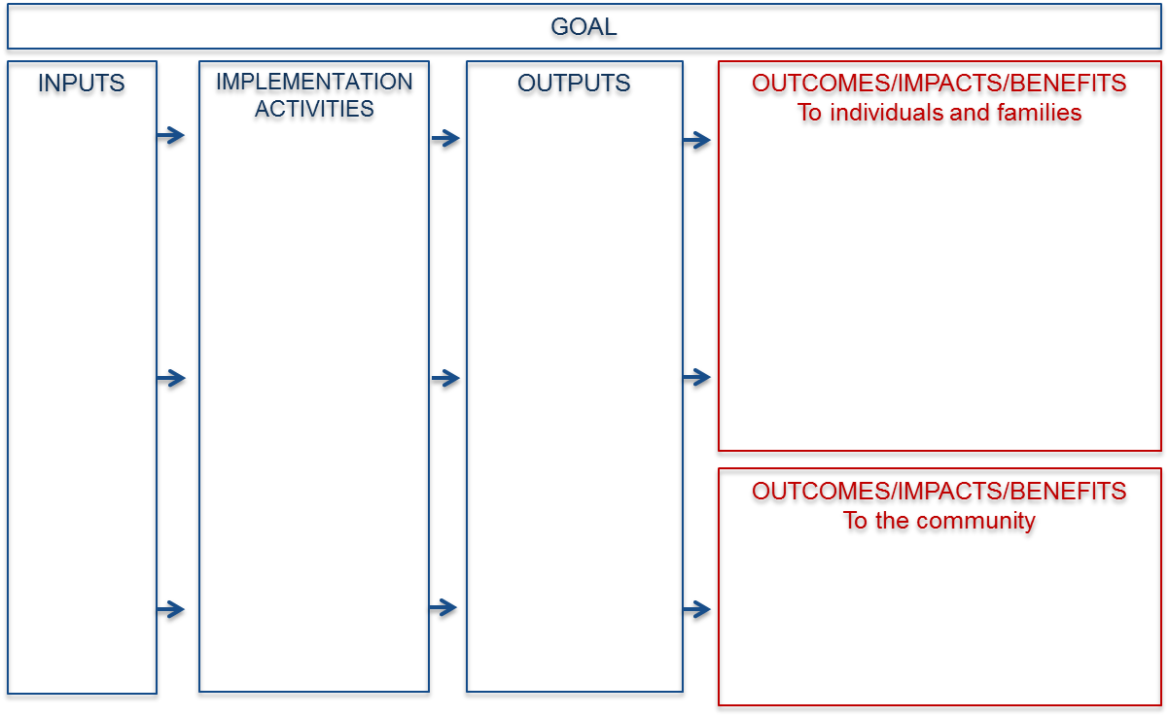
Defining Core Services
Start at the end: What are the primary benefits and outcomes that should result from your program?
Activities: What do you need to do to achieve those outcomes?
Outputs: What do the activities produce?

Slide 32
Monitoring
Logic model helps to monitor program implementation and quality
  Promotes shared understanding of goals and intended outcomes
  Identifies indicators for data collection and tracking
  Facilitates discussion of program logic and assumptions
PACT developed a web-based management information system for programs
  Conduct random assignment
  Enter data on all program contacts with fathers
  PACT team can view data at any time
PACT team produces biweekly or monthly reports on enrollment and participation
  Site liaisons share reports with program staff and discuss successes and ideas for improvement as needed

Slide 33

Monitoring Service Delivery
Brandi Jahnke, Regional Executive Director of Connections to Success in Kansas City

Slide 34
Keeping Men Engaged
ATTENDANCE

Slide 35
Program Engagement and Participation:
An Ongoing Challenge
Fathers who attend few—or no–services bring down average participation rates and dosage
  No-shows must be included in intent-to-treat analyses
High dosage of services for fathers maximizes chance of finding impacts
Maximizing participation can be challenging
  Changing contact information
  Chaotic and unstable lives
  Good reasons—e.g. getting a job, illness

Slide 36
Encouraging Initial Engagement
Strategies used by PACT RF programs:
Limit time between enrollment and program start
Use orientation to introduce program resources and build excitement
Develop a plan to guide program participation
Offer multiple opportunities to participate
Provide financial incentive after limited participation
Offer reductions in child support arrearages
Offer immediate support services, if needed

Slide 37
Promoting Ongoing Participation
Strategies used by PACT RF programs:
Offer a specified reduction in child support arrearages for every hour of participation or sustained employment
Offer financial incentives for attendance, completion, or employment
Make reminder calls to fathers
Reach out to fathers who miss sessions
When contact with a father is lost, reach out to other agencies with whom father is involved (e.g. child support enforcement, parole officers, treatment centers)
Host events and outings to facilitate father-child bonding
Provide condensed programming

Slide 38
Reaching Inactive Fathers
Despite best efforts, some fathers may not participate or participate only a minimal amount
Standard engagement strategies may not be sufficient
Ideas to engage inactive fathers:
  Compressed workshops
  Host a welcome back event
  Notify fathers of new upcoming (cohort-based) workshops
  Make enrolled fathers feel like they have a special opportunity

Slide 39
Tracking Participation
Monitor participation monthly through standard reports in management information system
  Engagement: percent of fathers who attend different parts of the program at least once
  Retention: percent of fathers who attend half or more of workshop sessions
  Dosage: average hours of attendance

Slide 40
Promoting Program Engagement
Brandi Jahnke, Regional Executive Director of Connections to Success in Kansas City

Slide 41
Questions?

